Slide 1
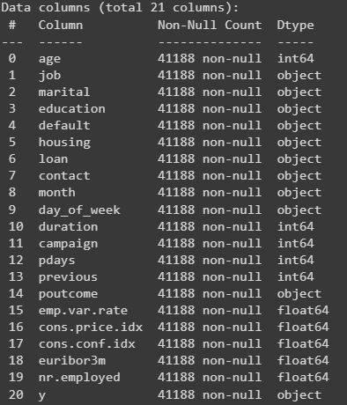
Exploratory Data Analysis (EDA)
Type of Data
Object - Categorical
int/float - Numerical
Our target variable: y
Training Model A: on 20 Features
Training Model B: on 5 selected Features

Slide 2
Exploratory Data Analysis (EDA)
Given Dataset Description:
Input variables:
# bank client data:
1 - age (numeric)
2 - job : type of job (categorical:"admin.","unknown","unemployed","management","housemaid","entrepreneur", "student”, "blue-collar","self-employed","retired","technician","services")
3 - marital : marital status (categorical: "married","divorced","single"; note: "divorced" means divorced or widowed)
4 - education (categorical: "unknown","secondary","primary","tertiary")
5 - default: has credit in default? (binary: "yes","no")
6 - balance: average yearly balance, in euros (numeric)
7 - housing: has housing loan? (binary: "yes","no")
8 - loan: has personal loan? (binary: "yes","no") # related with the last contact of the current campaign:
9 - contact: contact communication type (categorical: "unknown","telephone","cellular")
10 - day: last contact day of the month (numeric)
11 - month: last contact month of year (categorical: "jan", "feb", "mar", ..., "nov",dec")
12 - duration: last contact duration, in seconds (numeric)
# other attributes:
13 - campaign: number of contacts performed during this campaign and for this client (numeric,includes last contact)
14 - pdays: number of days that passed by after the client was last contacted from a previous campaign (numeric, -1 means client was not previously contacted)
15 - previous: number of contacts performed before this campaign and for this client (numeric)
16 - poutcome: outcome of the previous marketing campaign (categorical:"unknown","other","failure","success")
Output variable (desired target):
17 - y - has the client subscribed a term deposit? (binary: "yes","no")

Slide 3
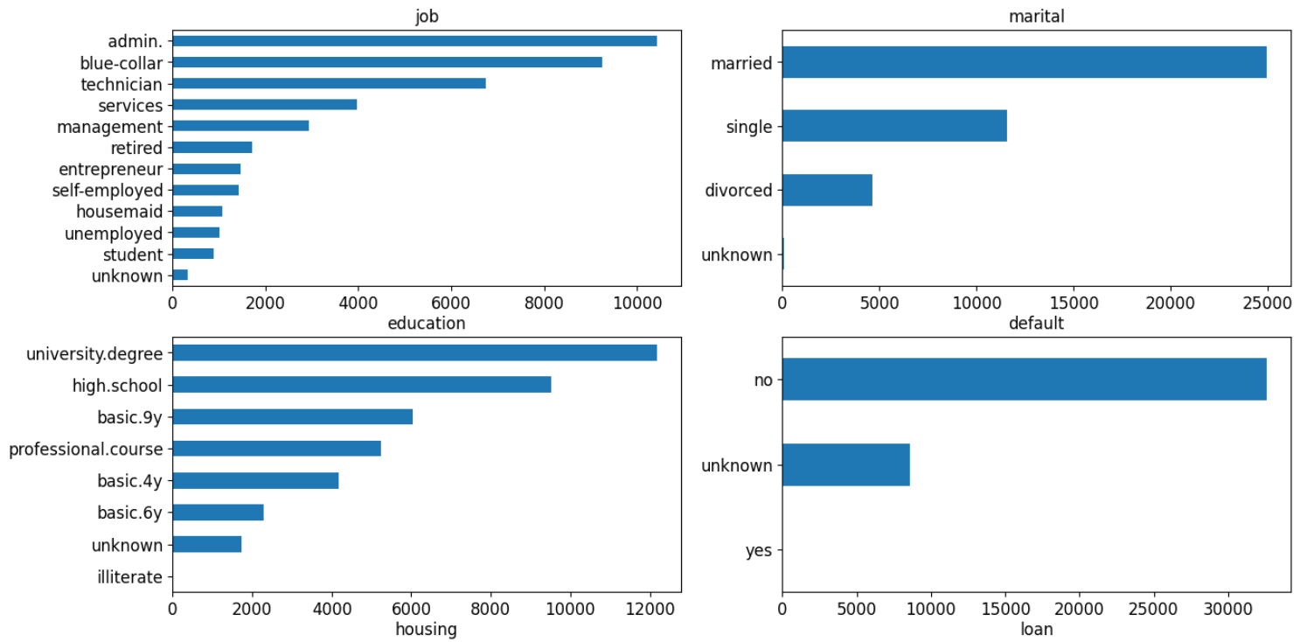
Categorical Data Analysis - Univariate
Less customers as students, more in administrative, blue collar or technician jobs
Majority customers have a university degree. There are no illiterate customers
Majority customers are married
No customers have default assumed credit

Slide 4
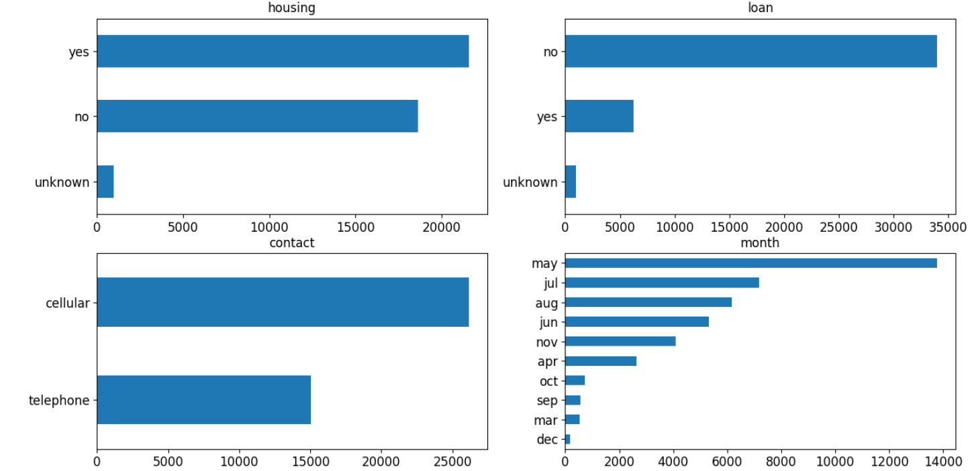
Categorical Data Analysis - Univariate
More than 50% have taken housing loan
More than 84% have taken personal loans
Major communication type is cellular
Most customers are contacted in May

Slide 5
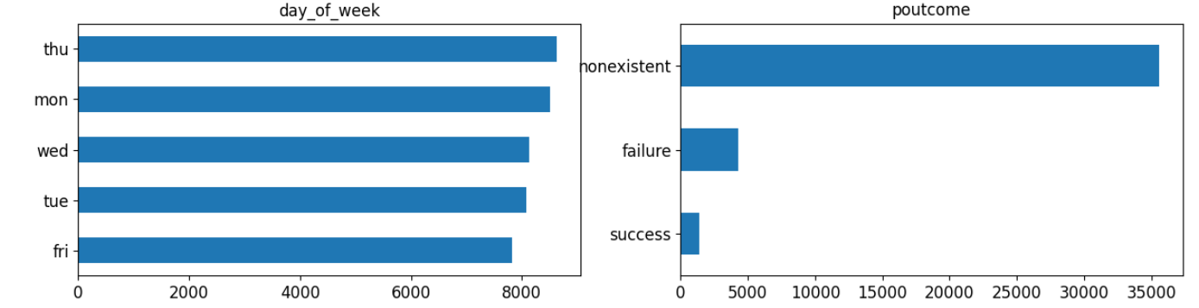
Categorical Data Analysis - Univariate
Majority of customers are contacted on Thursday, but days are fairly distributed
Most customers were not contacted previously

Slide 6
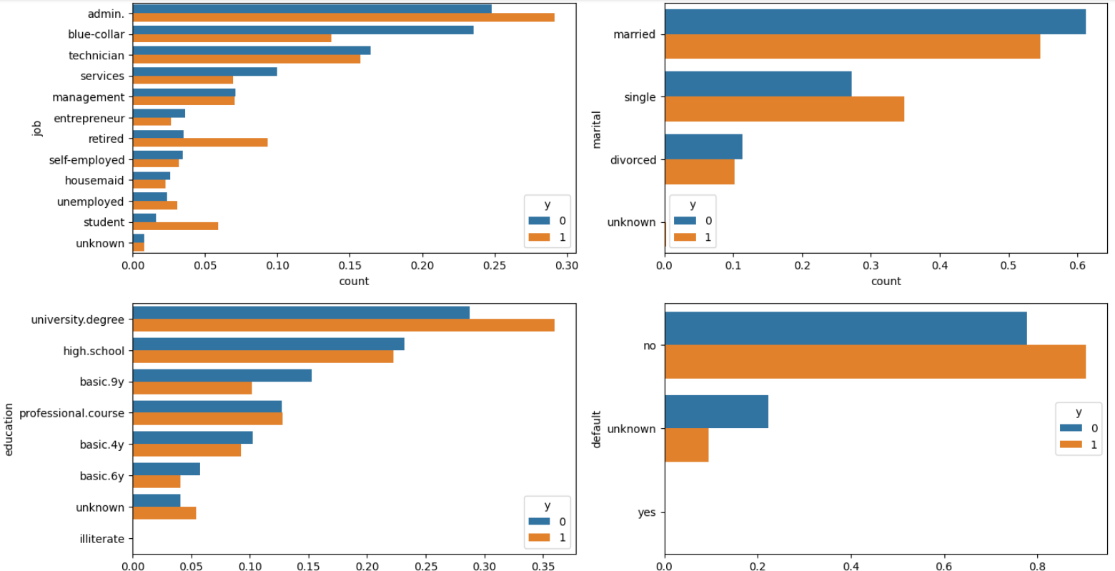
Categorical Data Analysis - Bivariate (against Target Variable)
More admin, students and retired customers subscribe
Single customers subscribe more than married customers
Customers with a university degree subscribe the most
No default customer analysis can be made

Slide 7
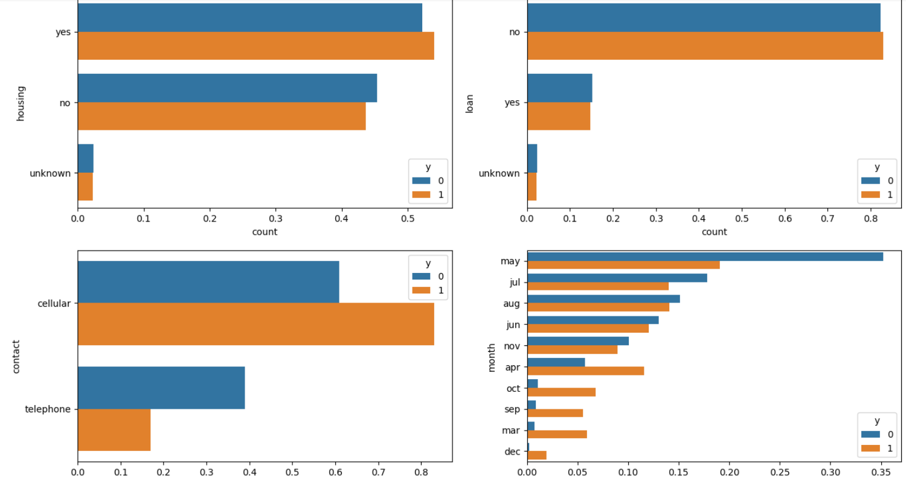
Categorical Data Analysis - Bivariate (against Target Variable)
Customers with housing and personal loan subscribe slightly more than those who do not have loan
Customers contacted through cellular subscribe much more
Customers subscribe more near fall (September onwards) than in Summer (May - Aug)

Slide 8
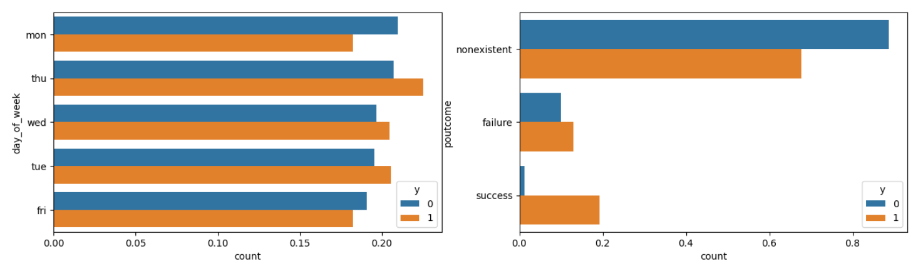
Categorical Data Analysis - Bivariate (against Target Variable)
Customers contacted previously subscribe more
Terminal Weekdays (Monday/Friday) contact days sees less subscription

Slide 9
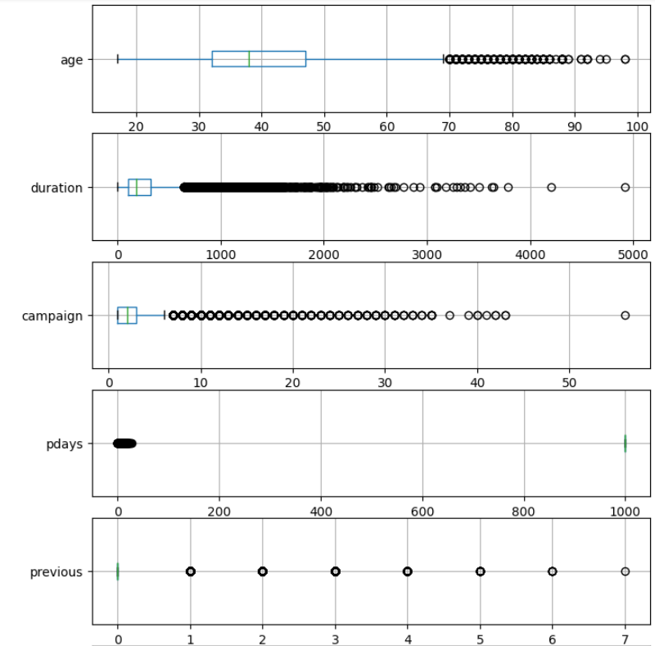
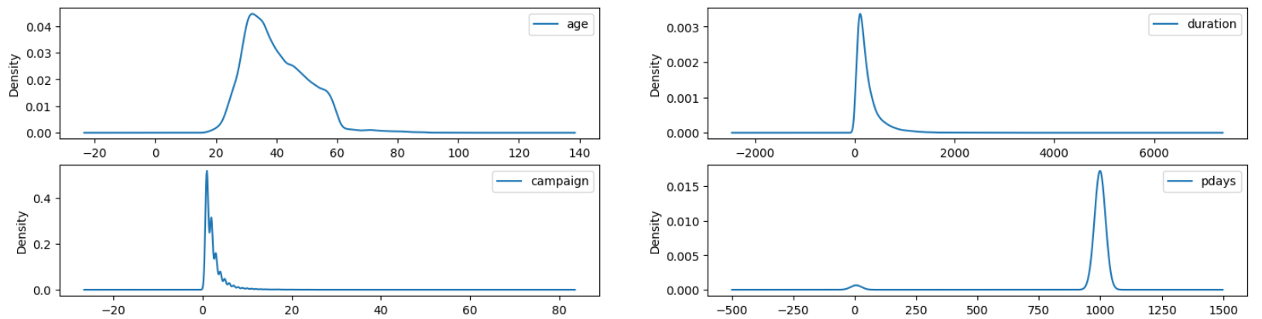
Numerical Data Analysis (Univariate)
Most of the customers have their age between 20-60
Only a single campaign took place, where majority were new customers

Slide 10
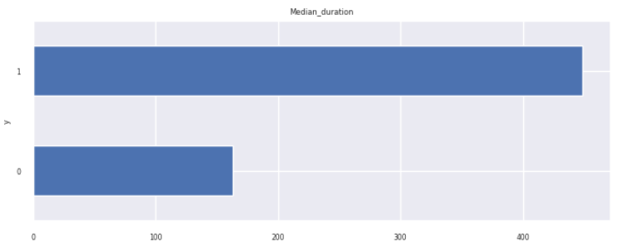
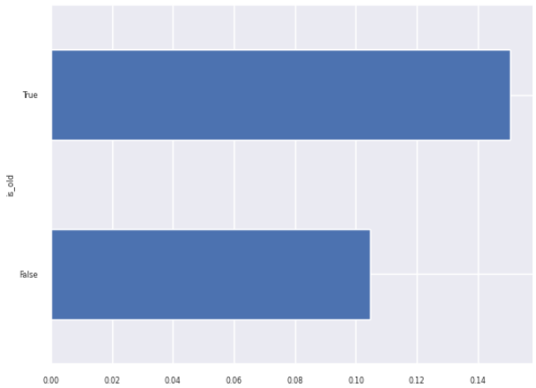
Numerical Data Analysis (Bivariate - against target)
Higher last contacted call duration causes more subscription
Considering people of Age > 50 to be older, more is the probability of subscribing

Slide 11
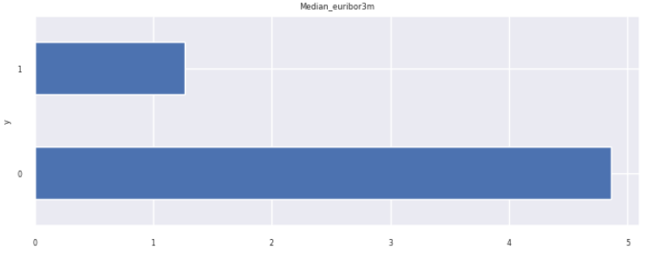
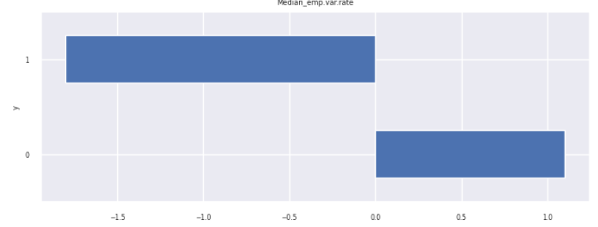
Numerical Data Analysis - more variables
cons.price.idx (Consumer Price Index):
cons.conf.idx (Consumer Confidence Index):
euribor3m (Euro Interbank Offered Rate, 3-month): Customers not availing rate found to subscribe more
emp.var.rate (Employment Variation Rate): Customers changing employment subscribe inversely (hence negative value)

Slide 12
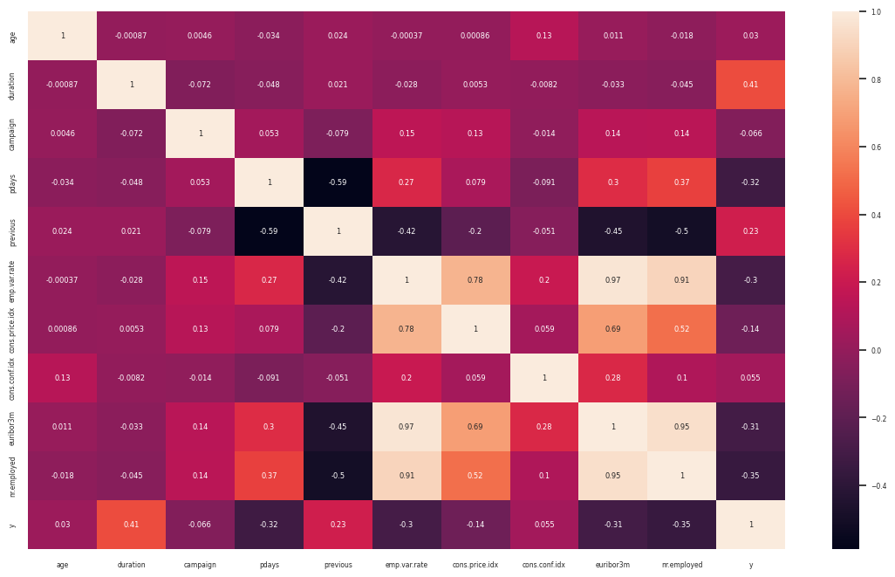
Numerical Analysis - Correlated Variables
Emp.var.rate, nr.employed, euroibo3m are highly correlated pairwise (>90%)
There seems to be a relation between customer availing the euro interbank rate and employment

Slide 13
Model A Choice
After converting Categorical to Numerical data through label encoding:
Grid Searched Hyperparameters for multiple models based on surveys, best for banking data, and on previous research related to this dataset:
Decision Tree (DT): benchmark
Logistic Regression (LR)
Naive Bayes (redundant in tuning)
Random Forest/Support Vector Machine (SVM): training timed out for 20 features
Best Performance choice for Model A: Logistic Regression
Why multiple models? To get feature importance accurately

Slide 14
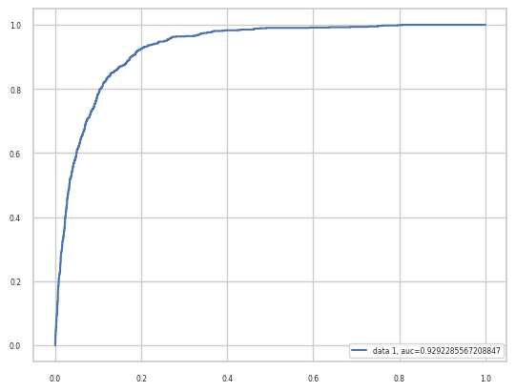
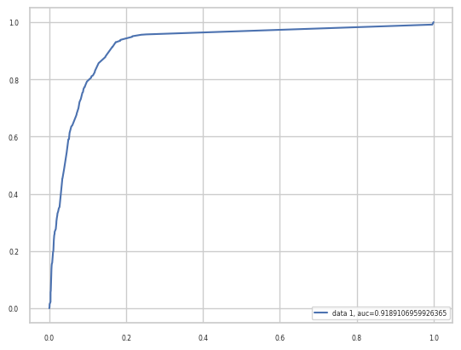
Model A: Logistic Regression
LR accuracy: 0.910592
Area under ROC Curve (LR) = 0.920
DT accuracy: 0.912352
Area under ROC Curve (LR) = 0.919

Slide 15
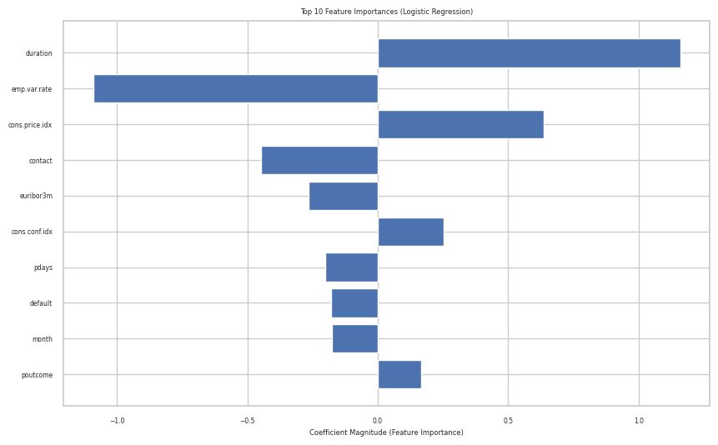
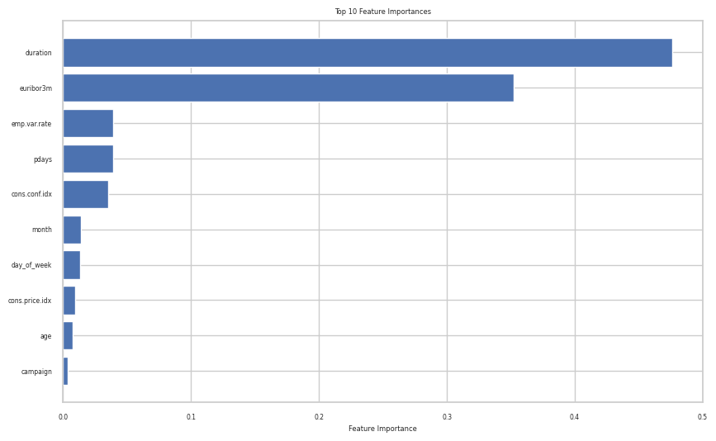
Top 5 Features
Logistic Regresssion vs Decision Tree: Feature Importance for top 10 features
Inverse yet equally important, choosing overlapping top_5
Features selected for Model B: 'duration', 'euribor3m', 'emp.var.rate', 'cons.conf.idx', 'cons.price.idx'

Slide 16
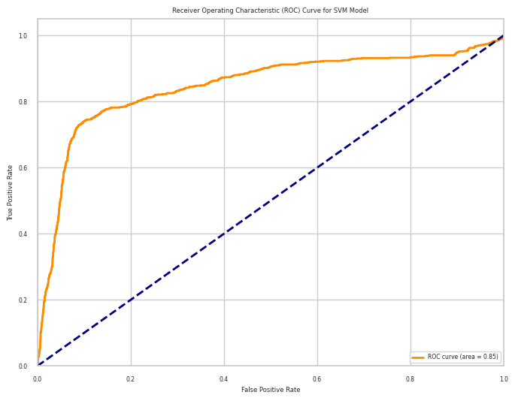
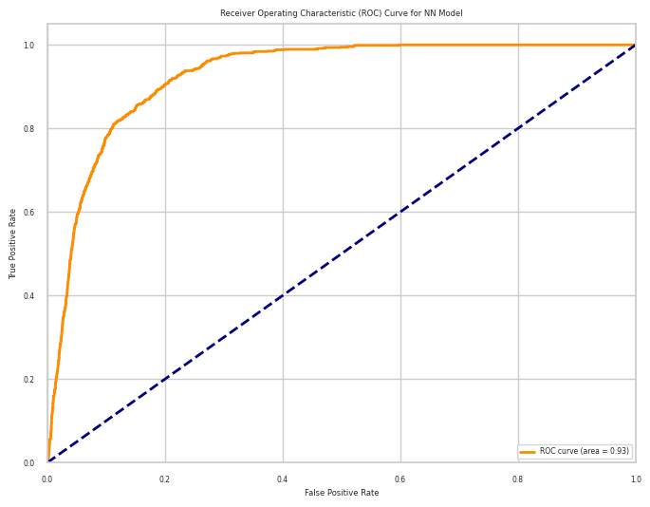
Model B: SVM vs MLP (NN)
Accuracy of SVM Model: 0.896091284292304
Area under ROC = 0.85
Accuracy of NN Model: 0.8980335032774945
Area under ROC = 0.93

Slide 17

Best Performance Test
Final Model B Choice: Neural Network (MultiLayer Perceptron)
Tested against Logistic Regression with 5 Features
Accuracy = 0.9049526584122359 AUC ROC = 0.92

Slide 18
Further Analysis
“A data-driven approach to predict the success of bank telemarketing” by Moro et. al. showcased the high performing data mining models on this dataset. The dataset was larger (with 150 features) but the dataset used in our study is having a subset of that data (with 20 features), also worked upon by the same author. AUC-ROC (Area under ROC Curve) measure has been taken for performance metric analysis, with Decision Tree (DT) and Neural Net (NN) models outperforming in certain cases
Model A should have been DT (the benchmark model A) according to the paper. Yet through hyperparameter tuning, we can see Logistic regression performing better for the 20 features
In Model B, MLP/NN Model performs slightly better than LR even with a lower accuracy, with 5 features. That is because the AUC-ROC is more, signifying that the model is able to distinguish better between the target variable. Naive Bayes Model was made to test performance time, permutation important (different from feature importance), and turned out to be redundant for analysis

Slide 19
Thank You

